Slide 1

REINFORCEMENT TEST
POWER BI
KISHORE VASUDEVAN
28/05/2025
DATA ANALYTICS & DATA SCIENCE
FEB 25'

Slide 2

INTRODUCTION
The car dataset contains details from 7 different brands, with 4 unique models under each brand. It includes information such as
Purchase year
Engine size
Fuel type
Transmission type
Mileage
Vehicle condition
Car price.

Slide 3
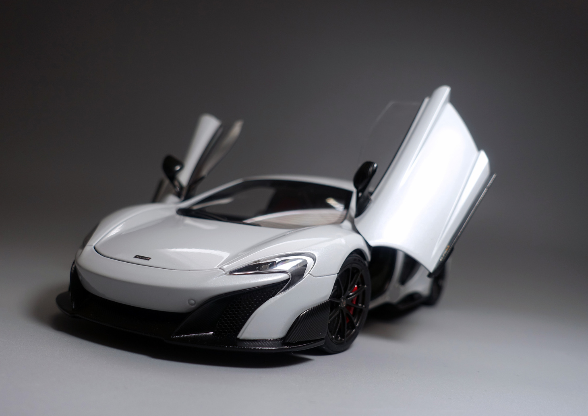
DATA PROCESSING
Import data into Power BI and then click transform data to load dataset into Power Query:
Duplicate checked
changed data types
DAX FUNCTIONS:
Minimum
Maximum
Average
Filter
If condition
Calculate

Slide 4
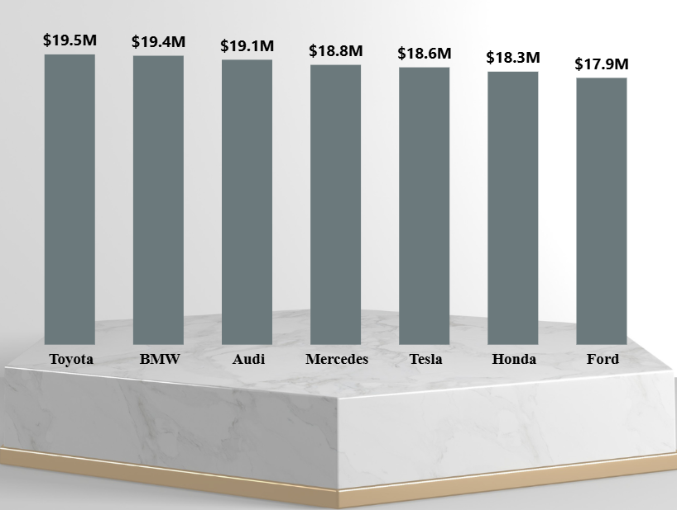
TOP 3

Slide 5
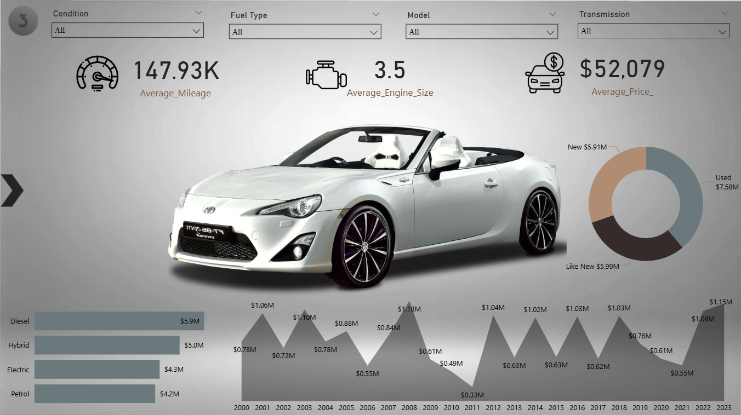

Slide 6
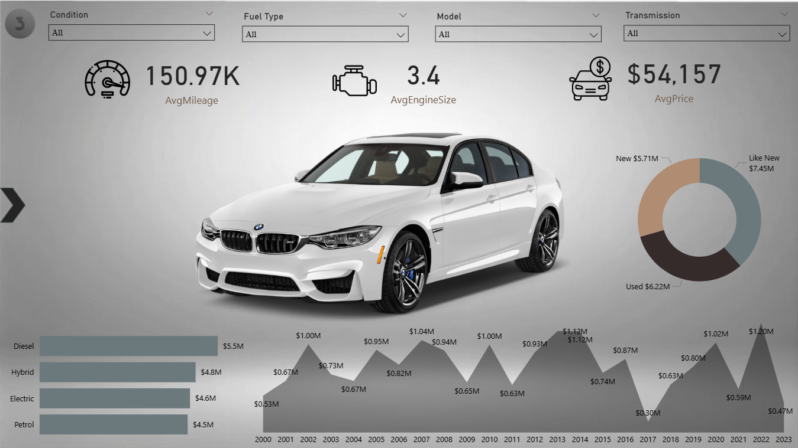

Slide 7
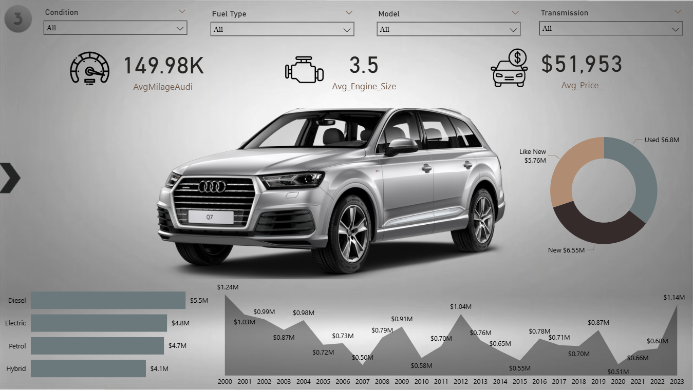

Slide 8
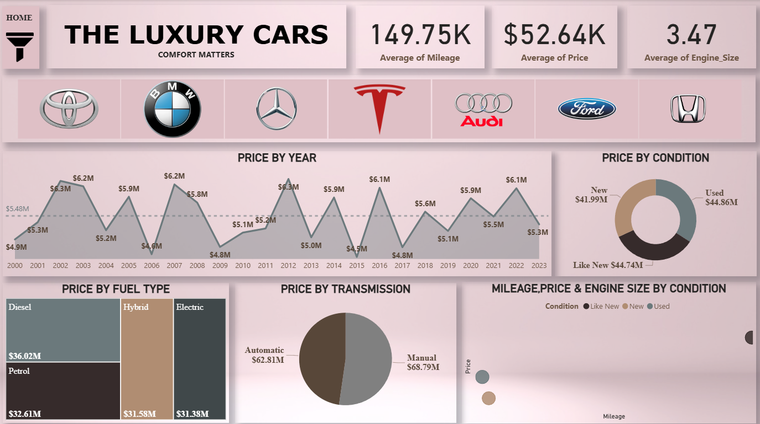

Slide 9
INSIGHTS
All cars have an engine size between 3.0 and 4.0 liters.
“Used cars” were the most preferred condition, followed by "Like New".
Diesel was the most preferred fuel type among the vehicles.
Manual transmission was the most commonly chosen transmission type.
Electric cars tend to have larger engine sizes compared to other fuel types.
On average, automatic cars have a slightly higher price than manual cars.

Slide 10
FINDINGS
Diesel is a preferred fuel type because it offers higher mileage.
In the U.S., although petrol is often cheaper than diesel, many still choose diesel vehicles for their superior fuel efficiency.
Alternatively, hybrid cars are a great option for fuel efficiency, as they mostly operate using electric motors.
Used cars with good mileage and in good condition can be a smart choice, offering cost savings without compromising much on performance.

Slide 11
CONCLUSION
Used luxury cars are the most preferred for their value and condition.
Diesel is favored for better mileage, while hybrids are chosen for fuel efficiency.
Manual cars lead in total value, though automatics are priced slightly higher.
Most vehicles have 3.0–4.0L engines, with electric cars having larger sizes.
Overall, buyers seek efficiency, performance, and smart savings.

Slide 12
THANK YOU

